Slide 1


Department of Artificial Intelligence and Machine Learning
Job Recommendation System Using Collaborative
Filtering and Content Based Filtering
B.Poongavin
(221801036)
K.S.Thejas
(221801056)
Mrs.D.Sornashanthi
Assistant-Professor

Slide 2
Problem Statement and Motivation
How might we create a skill/job recommender application using suitable technology, transforming career guidance by leveraging technology to match individuals with suitable jobs, fostering efficient employment and career development?
Motivation
Enhances employment rates by efficiently matching skills with market demands.
Provide personalized career advice tailored to individual needs.
Adapts to the dynamic job market.

Slide 3
Objectives
The objective of the job recommender application is to efficiently match individuals with suitable job opportunities based on their skills, experiences, and preferences. It aims to identify skill gaps and recommend relevant training programs for continuous professional development. By providing personalized career guidance, the application helps users make informed decisions about their career paths. It adapts to dynamic job market trends to offer up-to-date recommendations, ultimately enhancing job satisfaction and retention by aligning individuals with roles that best fit their abilities and interests

Slide 4
Abstract
This project presents a web-based job recommendation system developed using Flask, powered by Collaborative Filtering and Content-Based Filtering, two key techniques in data science. The system provides personalized job recommendations by combining user preferences and simulated interaction data with job attributes such as skills, experience, and qualifications. A pre-trained collaborative filtering model extracts latent features for users and jobs, enabling the computation of recommendation scores based on historical interactions. Simultaneously, the content-based filtering component uses natural language processing (NLP) to analyze job descriptions and match them with user profiles. By integrating these methods, the system ranks and displays the top jobs that align with the user's preferences, ensuring relevant and diverse recommendations.

Slide 5
Introduction and Overview of the Project.
Finding the right job in today’s competitive market can be overwhelming. This project introduces a web-based job recommendation system that provides personalized job suggestions using Collaborative Filtering and Content-Based Filtering techniques. Collaborative Filtering predicts user preferences by analyzing patterns in historical user-job interactions. Content-Based Filtering enhances recommendations by matching job descriptions with user profiles based on skills, qualifications, and interests.The hybrid approach combines these methods to ensure accurate, relevant, and diverse job recommendations. Developed using Flask, the system employs machine learning techniques for scoring and ranking job listings. This solution adapts to changing user needs and market trends, making it an efficient and scalable tool for personalized job matching.

Slide 6
Literature Survey
S.No | Author Name | Paper Title | Description | Jornal | Volume/ Year
1 | Badrul M. Sarwar, George Karypis, Joseph Konstan, John Riedl | Item-based Collaborative Filtering Recommendation Algorithms | Proceedings of the 10th International World Wide Web Conference | 2001 | Foundational paper on item-based collaborative filtering, a key technique for building recommendation systems. Important for recommending job roles or skills based on item similarity.
2 | Yehuda Koren, Robert Bell, Chris Volinsky | Matrix Factorization Techniques for Recommender Systems | IEEE Computer Society | Vol. 42, No. 8, 2009 | Discusses matrix factorization, a collaborative filtering method for uncovering latent factors from user preferences, crucial for skill and job match prediction in recommendation systems.

Slide 7
Literature Survey
S.No | Author Name | Paper Title | Description | Jornal | Volume/ Year
3 | Xiaoyuan Su, Taghi M. Khoshgoftaar | A Survey of Collaborative Filtering Techniques | Advances in Artificial Intelligence | 2009 | Comprehensive survey on collaborative filtering, covering user-based, item-based, and hybrid techniques, which are essential for developing robust skill and job recommendation systems.
4 | Guibing Guo, Jie Zhang, Daniel Thalmann | Merging Trust in Collaborative Filtering to Alleviate Data Sparsity and Cold Start | Knowledge-Based Systems | Vol. 57, 2014 | Addresses cold-start and data sparsity problems in recommendation systems by incorporating trust-based collaborative filtering, useful for recommending jobs or skills to new users with limited data.

Slide 8
Existing Sytem
Deep learning: is a subset of machine learning that focuses on using neural networks with multiple layers (often called deep neural networks) to model and solve complex problems. Deep learning has been highly successful in a variety of applications, such as image recognition, natural language processing, speech recognition, and more, due to its ability to automatically learn and extract features from raw data.
Content-based filtering: is a recommendation system technique that suggests items to users based on the content characteristics of items they have previously interacted with or shown interest in. This method primarily focuses on the properties of the items rather than relying on the preferences or behavior of other users, as is done in collaborative filtering.

Slide 9
Drawback of Existing System
The main drawback of existing system are :
1.Many platforms primarily use keyword matching to connect job seekers with listings.
2.Some systems do not leverage user data effectively to personalize job recommendations.
3.Job listings on some platforms can be outdated or incomplete.
4. Extensive use of personal data by AI-driven platforms raises privacy and security issues.
5. Many platforms lack robust mechanisms for collecting and incorporating user feedback.
6. Some platforms have complex interfaces that are not user-friendly.

Slide 10
Proposed System
1.The system provides personalized job recommendations based on the skills entered by the user, ensuring a closer match between job requirements and candidate abilities.
2.The automated recommendation system saves time by instantly providing users with a curated list of jobs that align with their skills.
3.By analyzing both job descriptions and user input, the system identifies relevant job opportunities, even for niche or specialized skill sets.
4. The system can help users in transition by matching them with jobs where their new skills are relevant, enabling smoother career changes.

Slide 11
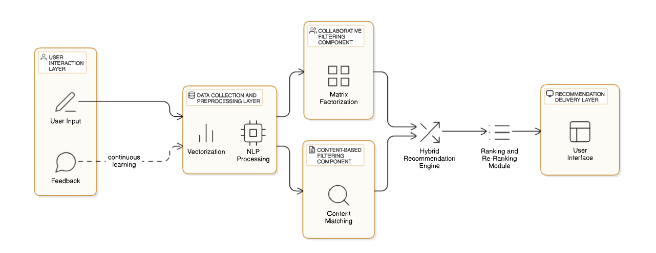
System Architecture

Slide 12

List of modules 1
Collaborative Filtering is a recommendation system that suggests items to users based on the preferences of similar users. It works by analyzing past interactions, such as ratings, clicks, or purchases, to find patterns. There are two types: User-Based and Item-Based. In User-Based, the system finds users with similar tastes and recommends items they liked. In Item-Based, the system recommends items that are similar to those the user has already liked. This method doesn’t require detailed information about the items, just user behavior. It’s widely used in platforms like Netflix and Amazon, but it can struggle with new users or items that have little data. Despite this, it’s a popular and effective way to make personalized recommendations.

Slide 13

List of modules 2
Content-Based Filtering is a recommendation system that suggests items to users based on the features of the items and the user’s preferences or past behavior. It works by analyzing the characteristics of items and matching them with the user's profile, which is built from their previous interactions, likes, or preferences. For example, if a user likes movies of a certain genre, the system will recommend other movies from that genre. It uses techniques like TF-IDF (to measure the importance of terms in the item descriptions) or word embeddings to represent items and user profiles. Content-based filtering doesn’t rely on other users’ data, making it effective for recommending new or niche items. However, it can be limited in variety, as it mainly recommends items similar to what the user has already interacted with. It’s commonly used in platforms like Netflix or job recommendation sites.

Slide 14
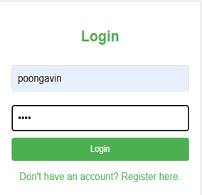
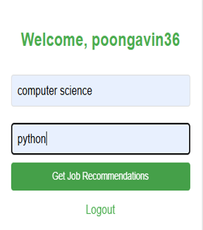
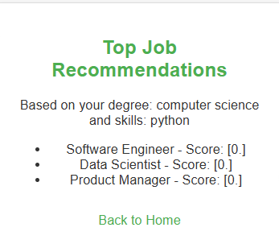
Output of modules 3

Slide 15
Result and Discussion
The job recommendation system combined Collaborative Filtering and Content-Based Filtering to suggest relevant jobs. Collaborative Filtering used the preferences of similar users to find good job matches, while Content-Based Filtering matched job descriptions to a user's skills and experience. This combination helped provide a wider variety of job suggestions and avoided repeating recommendations. The system worked well with large data, but future improvements could include using Deep Learning and Graph-Based Algorithms for even better results.

Slide 16
Conclusion
The job recommendation system, which combines Collaborative Filtering and Content-Based Filtering, provides users with personalized and relevant job suggestions. By using these two techniques together, the system can offer more accurate recommendations, even for new users or those with limited interaction history. Collaborative Filtering helps identify similar users to predict job preferences, while Content-Based Filtering matches jobs to user profiles based on skills and experience. The hybrid approach improves the diversity and quality of job recommendations, leading to higher user satisfaction.

Slide 17
References
Schafer, J. B., Frankowski, D., Herlocker, J., & Sen, S. (2007). Collaborative Filtering Recommender Systems. Foundations and Trends in Human–Computer Interaction, 1(3), 139–220.
Ricci, F., Rokach, L., & Shapira, B. (2015). Recommender Systems Handbook. Springer Science & Business Media.
Adomavicius, G., & Tuzhilin, A. (2005). Toward the Next Generation of Recommender Systems: A Survey of the State-of-the-Art and Possible Extensions. IEEE Transactions on Knowledge and Data Engineering, 17(6), 734–749.
Su, X., & Khoshgoftaar, T. M. (2009). A Survey of Collaborative Filtering Techniques. Advances in Artificial Intelligence, 2009, 1–19.
Zhao, J., & Zhang, M. (2015). Collaborative Filtering for Recommender Systems: A Survey. IEEE Transactions on Systems, Man, and Cybernetics: Systems,45(6),713–722.
Jannach, D., & Adomavicius, G. (2016). Recommender Systems: Challenges and Research Opportunities. IEEE Internet Computing, 20(4), 3–8.

Slide 18
Thank You

